Slide 1


Game Analysis With SQL
Mentorness Internship Project by Shivathmika
Batch: MIP-DA-06

Slide 2
Content
Project Overview
Data Origins and Approaches
Data Set Description
Data Ingestion and Transformation
Analysis(Queries)
Key Takeaways

Slide 3
Project Overview:
Decoding gaming behavior through SQL query analysis involves delving into the intricate details of player interactions and performance within a gaming environment. Analysts can uncover valuable insights into player engagement, skill development, and game mechanics optimization by leveraging a dataset that contains information on player details and level progression.

Slide 4
Data Origins and Approaches
Mentorness graciously supplied the dataset for this project.
This data encompasses diverse metrics such as player demographics, game performance indicators, in-game transactions, player interactions, and other relevant gameplay statistics.
The dataset is organized in a manner conducive to SQL analysis, enabling the extraction of insights and patterns through querying and manipulation using SQL queries.
Overall, the dataset serves as a rich resource for conducting comprehensive analyses aimed at understanding player behavior, game dynamics, and performance metrics within the gaming environment.

Slide 5
Dataset Description
The dataset comprises two tables: ‘Player Details’ and ‘Level’ Details’
Player Details Table:
`P_ID`: Player ID
`PName`: Player Name
`L1_status`: Level 1 Status
`L2_status`: Level 2 Status
`L1_code`: Systemgenerated Level 1 Code
`L2_code`: Systemgenerated Level 2 Code
Level Details Table:
`P_ID`: Player ID
`Dev_ID`: Device ID
`start_time`: Start Time
`stages_crossed`: Stages Crossed
`level`: Game Level
`difficulty`: Difficulty Level
`kill_count`: Kill Count
`headshots_count`: Headshots Count
`score`: Player Score
`lives_earned`: Extra Lives Earned

Slide 6
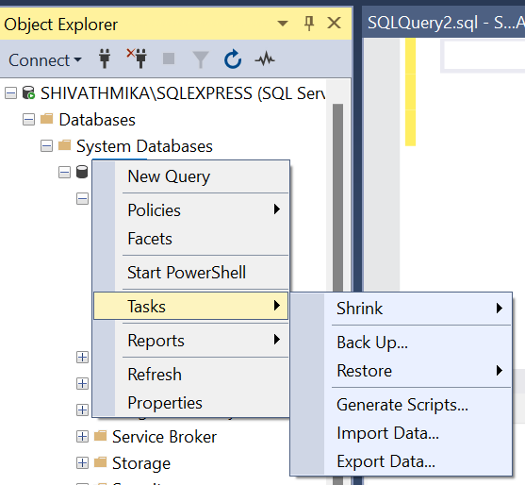
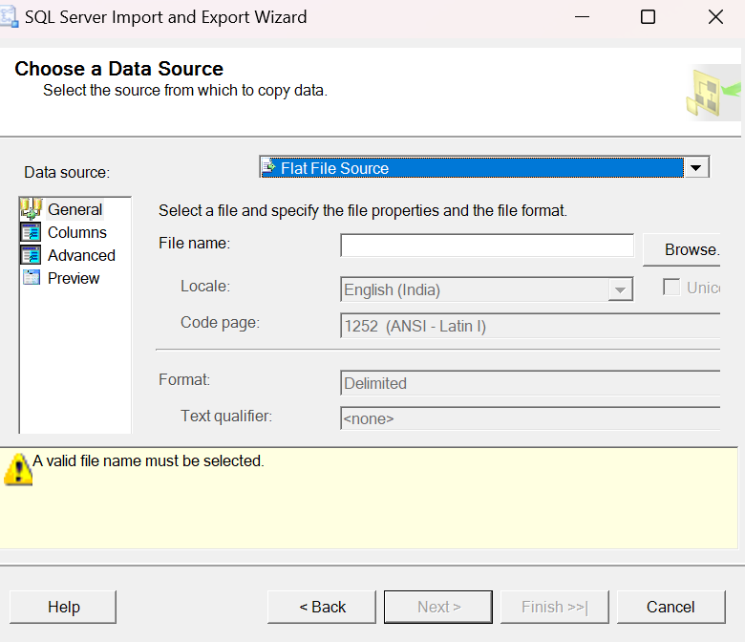
Data Ingestion:
The default database will be created as "master.“
Import CSV files into MySQL Database "We have to import it as a flat file.“

Slide 7
Data Transformation:
1)Modification of Columns:
alter table pd modify L1_Status varchar(30);
alter table pd modify L2_Status varchar(30);
alter table pd modify P_ID int primary key;
alter table ld add primary key(P_ID,Dev_id,start_datetime);
alter table ld change timestamp start_datetime datetime;
alter table id modify Dev_Id varchar(10);
alter table id modify Difficulty varchar(15);
2)Drop Columns:
alter table pd drop myunknowncolumn;
alter table ld drop myunknowncolumn;

Slide 8
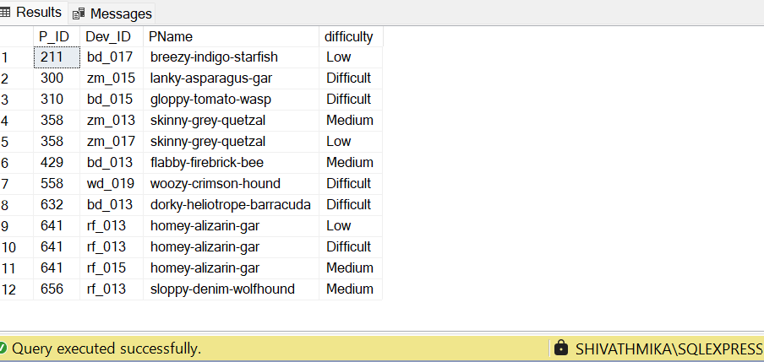
Query1: Extract the `P_ID`, `Dev_ID`, `PName`, and `Difficulty_level` of all players at Level 0.
Query:
select level_details.P_ID,Dev_ID,PName,difficulty
from level_details left join player_details
on level_details.P_ID=player_details.P_ID
where Level=0;

Slide 9
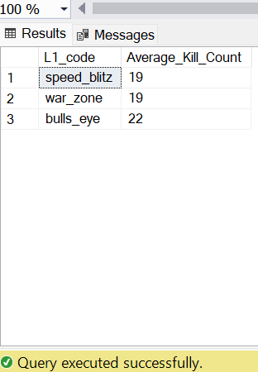
Query 2: Find `Level1_code`wise average `Kill_Count` where `lives_earned` is 2, and at least 3 stages are crossed.
select L1_code,avg(kill_count) as Average_Kill_Count
from player_details left join level_details
on level_details.P_ID=player_details.P_ID
where lives_earned=2 and stages_crossed>=3
group by L1_code
order by Average_Kill_Count;

Slide 10
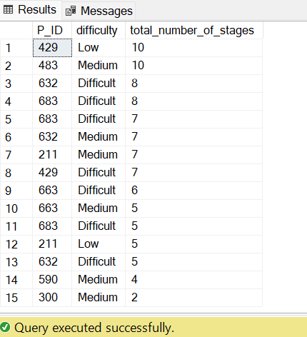
Query 3: Find the total number of stages crossed at each difficulty level for Level 2 with players using `zm_series` devices. Arrange the result in decreasing order of the total number of stages crossed.
select P_ID,difficulty,stages_crossed as total_number_of_stages
from level_details
where level=2 and Dev_ID like 'zm_%'
order by stages_crossed desc;

Slide 11
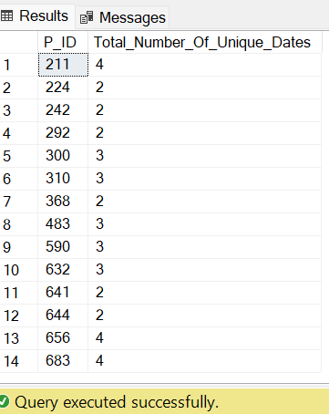
Query 4: Extract `P_ID` and the total number of unique dates for those players who have played games on multiple days.
SELECT P_ID, COUNT(DISTINCT CAST(start_datetime AS DATE)) AS Total_Number_Of_Unique_Dates
FROM level_details
GROUP BY P_ID
HAVING COUNT(DISTINCT CAST(start_datetime AS DATE)) > 1;

Slide 12
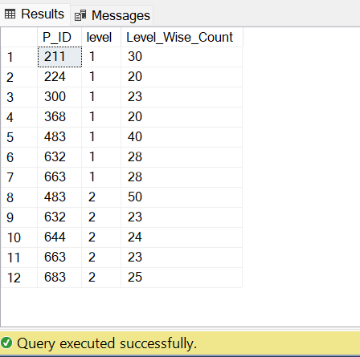
Query 5: Find `P_ID` and levelwise sum of `kill_counts` where `kill_count` is greater than the average kill count for Medium difficulty.
Select P_ID,level,sum(Kill_Count) AS Level_Wise_Count
from level_details
where Difficulty="Medium"
group by P_ID,
level having avg(Kill_Count)>
(select avg(Kill_Count) from level_details where Difficulty="Medium");

Slide 13
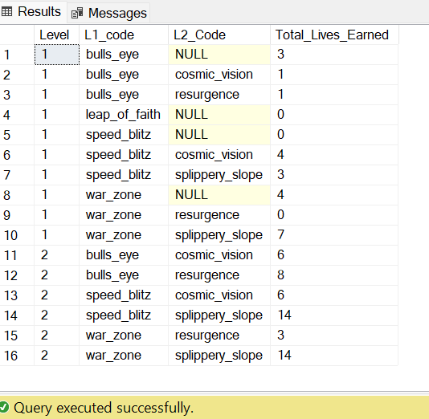
Query 6: Find `Level` and its corresponding `Level_code`wise sum of lives earned, excluding Level 0. Arrange in ascending order of level.
select Level,L1_code,L2_Code,sum(lives_earned) as Total_Lives_Earned
from level_details left join player_details on level_details.P_ID=player_details.P_ID
group by level,L1_Code,L2_Code
having level !=0 order by level;

Slide 14
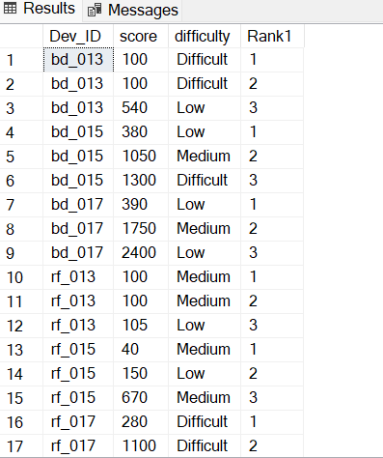
Query 7: Find the top 3 scores based on each `Dev_ID` and rank them in increasing order using `Row_Number`. Display the difficulty as well.
select Dev_ID,score,difficulty,Rank1 from(
select Dev_ID,score,difficulty,row_number() over (partition by Dev_ID order by score asc) as Rank1 from level_details)
as ranked where Rank1<=3;

Slide 15
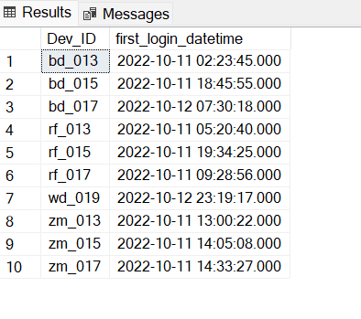
Query 8: Find the `first_login` date-time for each device ID.
select Dev_ID,min(start_datetime)as first_login_datetime
from level_details
group by Dev_Id;

Slide 16
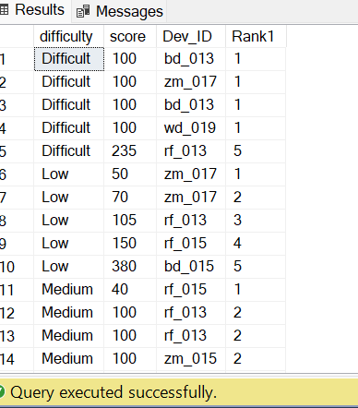
Query 9: Find the top 5 scores based on each difficulty level and rank them in increasing order using `Rank`. Display `Dev_ID` as well.
select difficulty,score,Dev_ID,Rank1 from(
select difficulty,score,Dev_ID,rank() over (partition by Difficulty order by score asc) as Rank1 from level_details )
as ranked where Rank1<=5;

Slide 17
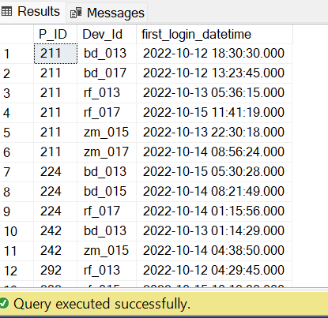
Query 10: Find the device ID that is first logged in (based on `start_datetime`) for each player (`P_ID`). The output should contain player ID, device ID, and first login date-time.
select P_ID,Dev_Id,min(start_datetime)as first_login_datetime
from level_details
group by P_ID,Dev_Id;

Slide 18
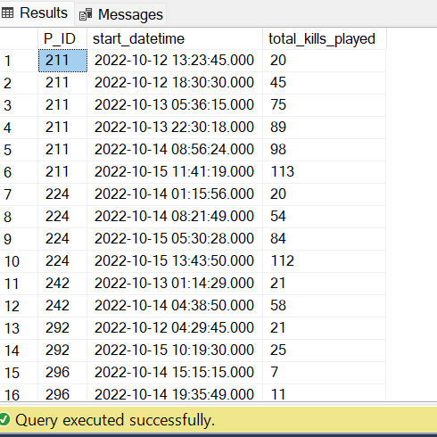
Query 11: For each player and date, determine how many `kill_counts` were played by the player so far. a) Using window functions b) Without window functions
a)Using window function
SELECT
P_ID,
start_datetime,
SUM(kill_count) OVER (PARTITION BY P_ID ORDER BY start_datetime) AS total_kills_played
FROM
level_details;

Slide 19
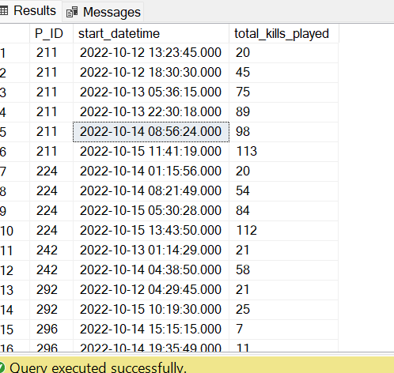
b)Without Using Window Function
SELECT
t1.P_ID,
t1.start_datetime,
(SELECT SUM(t2.kill_count)
FROM level_details t2
WHERE t2.P_ID = t1.P_ID AND t2.start_datetime <= t1.start_datetime) AS total_kills_played
FROM
level_details t1
ORDER BY
t1.P_ID,t1.start_datetime;

Slide 20
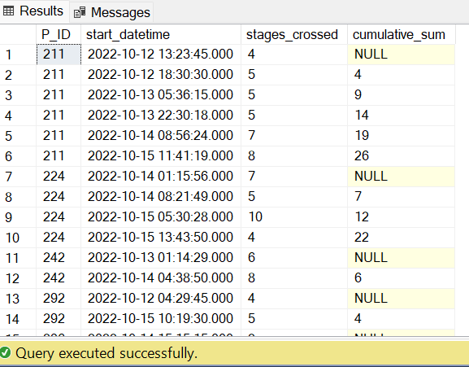
Query 12: Find the cumulative sum of stages crossed over `start_datetime` for each `P_ID`, excluding the most recent `start_datetime`.
select P_ID,start_datetime,stages_crossed,
sum(Stages_crossed) over (partition by P_ID order by start_datetime asc rows between unbounded preceding and 1 preceding )as cumulative_sum
from level_details order by P_ID,start_datetime;

Slide 21
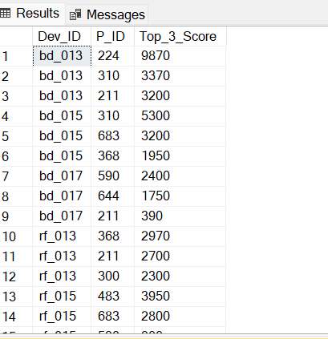
Query 13: Extract the top 3 highest sums of scores for each `Dev_ID` and the corresponding `P_ID`.
select Dev_ID,P_ID,Top_3_Score from(
select Dev_ID,P_ID,sum(score) As Top_3_Score,row_number() over(partition by Dev_Id order by sum(score)desc)as rank1
from level_details
group by Dev_Id,P_ID)as subquery
where rank1<=3;

Slide 22
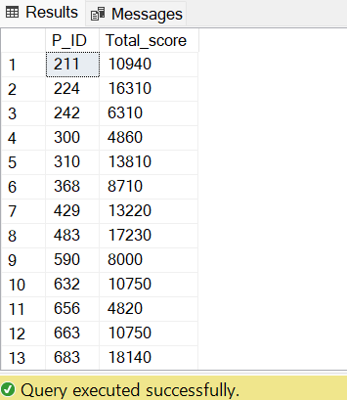
Query 14: Find players who scored more than 50% of the average score, scored by the sum of scores for each `P_ID`.
SELECT
P_ID,
SUM(score) AS Total_score
FROM
level_details
GROUP BY
P_ID
HAVING
SUM(score) > (
SELECT
0.5 * AVG(Total_score)
FROM (
SELECT
P_ID,
SUM(score) AS Total_score
FROM
level_details
GROUP BY
P_ID )
);

Slide 23
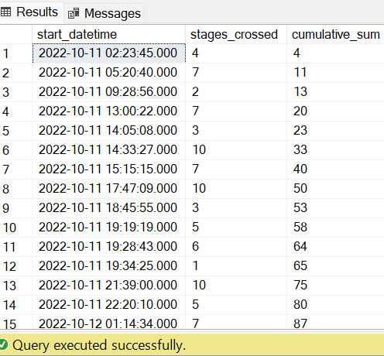
Query 15: Find the cumulative sum of stages crossed over a start_datetime
Select
start_datetime,stages_crossed,sum(stages_crossed) over (order by start_datetime)as cumulative_sum from level_details;

Slide 24
THANK YOU

